Slide 1
INTRO
Stichpunkte

Slide 2
INTRO
Stichpunkte

Slide 3
INTRO
Stichpunkte

Slide 4
INTRO
Stichpunkte

Slide 5

Copula
Joint CDF with uniform margins
Decouples margins and dependence
NAC allow (partial) asymmetry
$$C\left(u_{1},u_{2},u_{3}\right)=C_{1}\left({u_{3},C}_{2}\left(u_{1},u_{2}\right)\right)$$
Notes:
Will not introduce a lot of theory
Keep it intro level friendly
Thus:
Applied NAC example
Basic theory:
Copula is a joint cdf with uniform margins (more on that later. For now think of it as just a function)
Allows to decouple marginal distribution and dependence strucutre
NAC special AC that allow partial asymmetry FORMULA
CDF:
- Function that gives probability X<= x

Slide 6
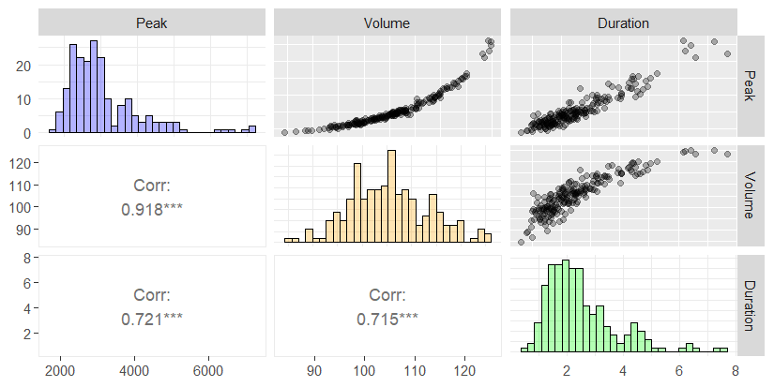
Example
Notes:
Barplot, Scatterplot and Kendall‘s tau
Note on Kendall‘s tau: Think of it as more robust Pearson correlation coefficient

Slide 7
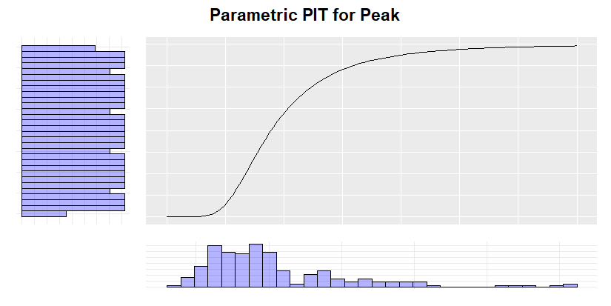
Probability Integral Transform
Notes:
SHOW psuedo obs plot
Copula (Note towards asymmetry in Scatterplots and Limitations of NACs)
Using PIT, we obtain pseudo observations
R sim for PIT?

Slide 8
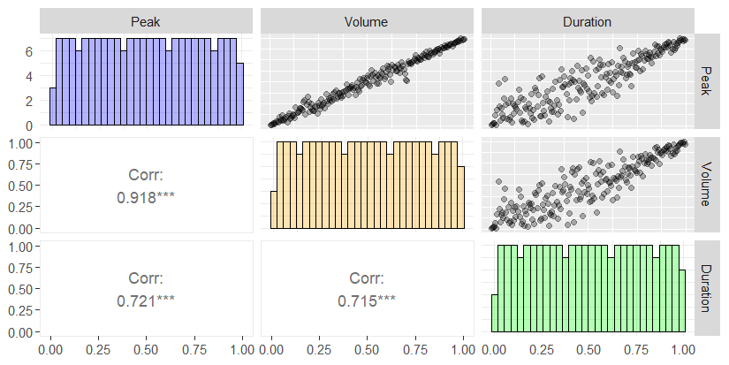
Probability Integral Transform

Slide 9
Goodness of Fit

Slide 10
Outlook (1)
Stichpunkte

Slide 11
Outlook (2)
Statistik heavy

